Slide 1
Optimising Rail Networks in California

Slide 2
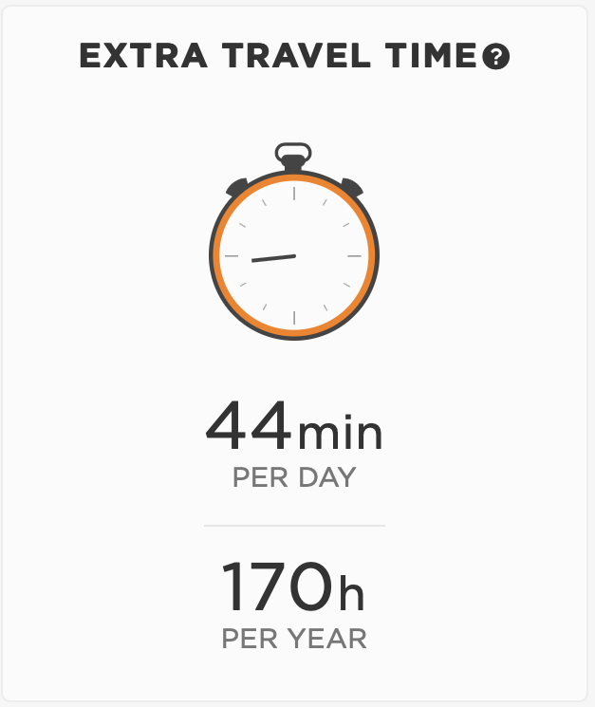
California has a transport problem
£77.3 billion
New Rail System

Slide 3
Transport will improve jobs prospects
Strong Correlation
between
Income & commuting
mode, time and access
Decision tree
Accuracy: 82%
Precision: 71%
Recall: 74%

Slide 4
Establishing clusters of jobs and workers
K-MEANS
Unsupervised Learning
Clustering
Jobs
clustering
Workers
clustering

Slide 5
Our proposed train networks
5
10
15
20
Minimum Spanning Tree
With flow network optimisation

Slide 6
Further Optimisation
0.10
0.15
0.21
0.05
0.37
0.21
0.15
0.13
0.12
0.21
0.08
0.31
0.06
0.15

Slide 7
Evaluation

